Slide 1
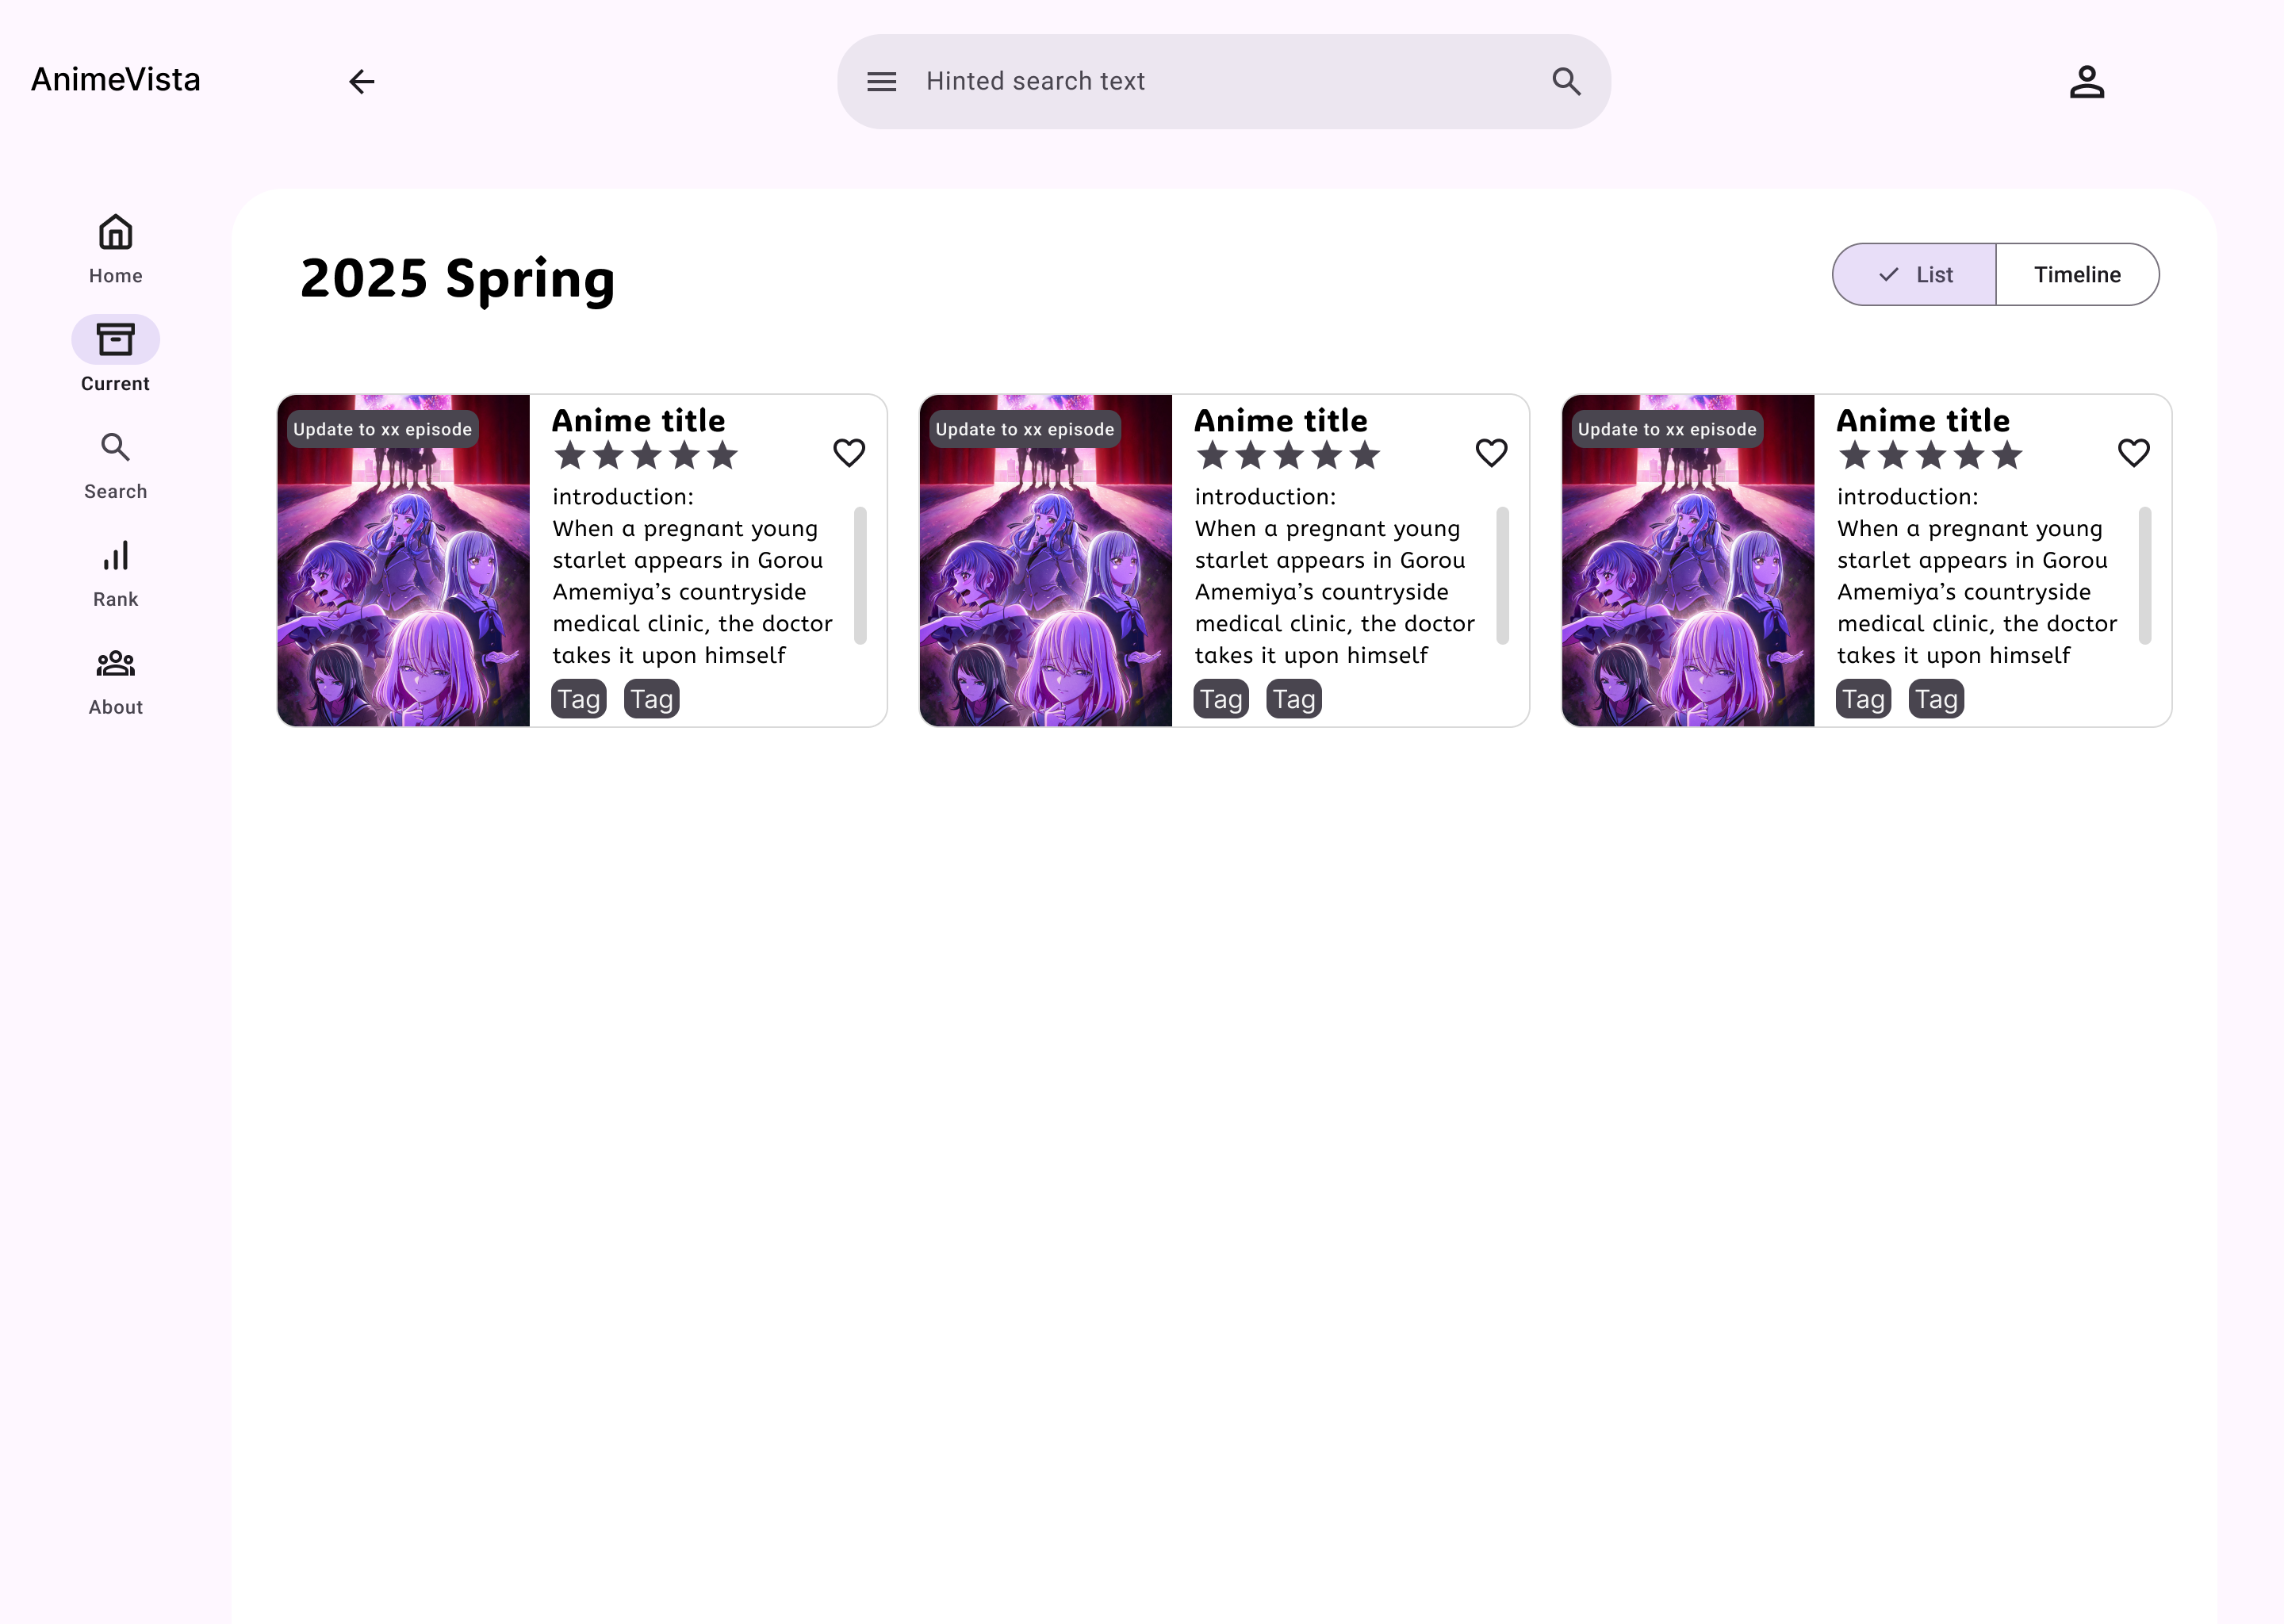
src/App.jsx
src/components/layout/TopBar.jsx
该区域为XXXPresenter
边框和字体颜色仅用于方便视觉区分，无特殊含义
src/components/layout/SideBar.jsx
Notes:
此处标注页面名和对应目录
本页注意：
App.jsx为全局框架，所有Presenter都挂载于该文件内
TopBar 和 SideBar 所有页面都存在，因此也挂载于 App.jsx内
页面主体为 XXXPresenter，需根据路由决定显示什么内容
后续 PPT 仅显示写出 XXXPresenter 的结构，TopBar & SideBar & App.jsx 省略不提

Slide 2
src/views/Current/components/SeasonTitle.jsx
src/views/Current/components/Switcher.jsx
src/presenters/CurrentPresenter.jsx
src/views/Current/CurrentView.jsx
src/views/Current/CurrentListView.jsx
src/views/Current/components/ListCard.jsx
（复用src/components/card/IntroCard.jsx）
List
Notes:
页面名：Current Season – List
view 目录：src/views/Current
model 目录：src/models/current

Slide 3
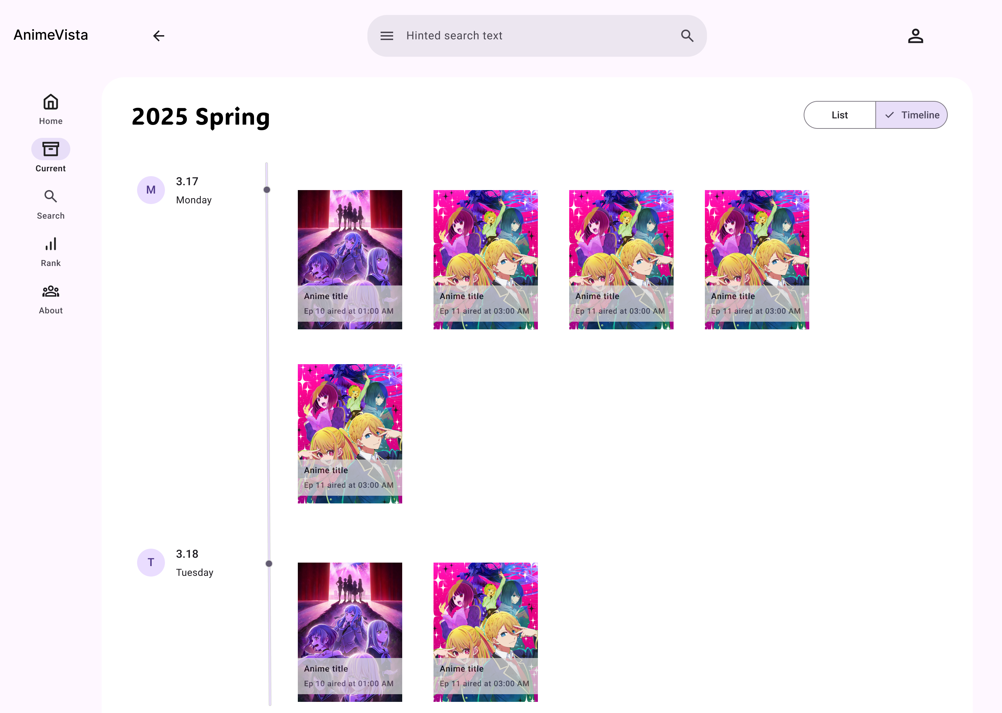
src/views/Current/components/SeasonTitle.jsx
src/views/Current/components/Switcher.jsx
src/presenters/CurrentPresenter.jsx
src/views/Current/CurrentView.jsx
src/views/Current/CurrentTimelineView.jsx
src/views/Current/components/Timeline/BriefCard.jsx
src/views/Current/components/Timeline/TimePoint.jsx
src/views/Current/components/Timeline/Time.jsx
src/views/Current/components/Timeline/Content.jsx
Notes:
页面名：Current Season - Timeline
view 目录：src/views/Current
model 目录：src/models/current

Slide 4

src/presenters/HomePresenter.jsx
src/views/Home/HomeView.jsx
src/views/Home/components/Recommendation.jsx
src/views/Home/components/PopularityTitle.jsx
src/views/Home/components/Popularity.jsx
src/views/Home/components/PopularityList.jsx
src/views/Home/components/PopularityListItem.jsx
(仅下方有分割线)
Notes:
页面名：Home
view 目录：src/views/Home
model 目录：src/models/home

Slide 5
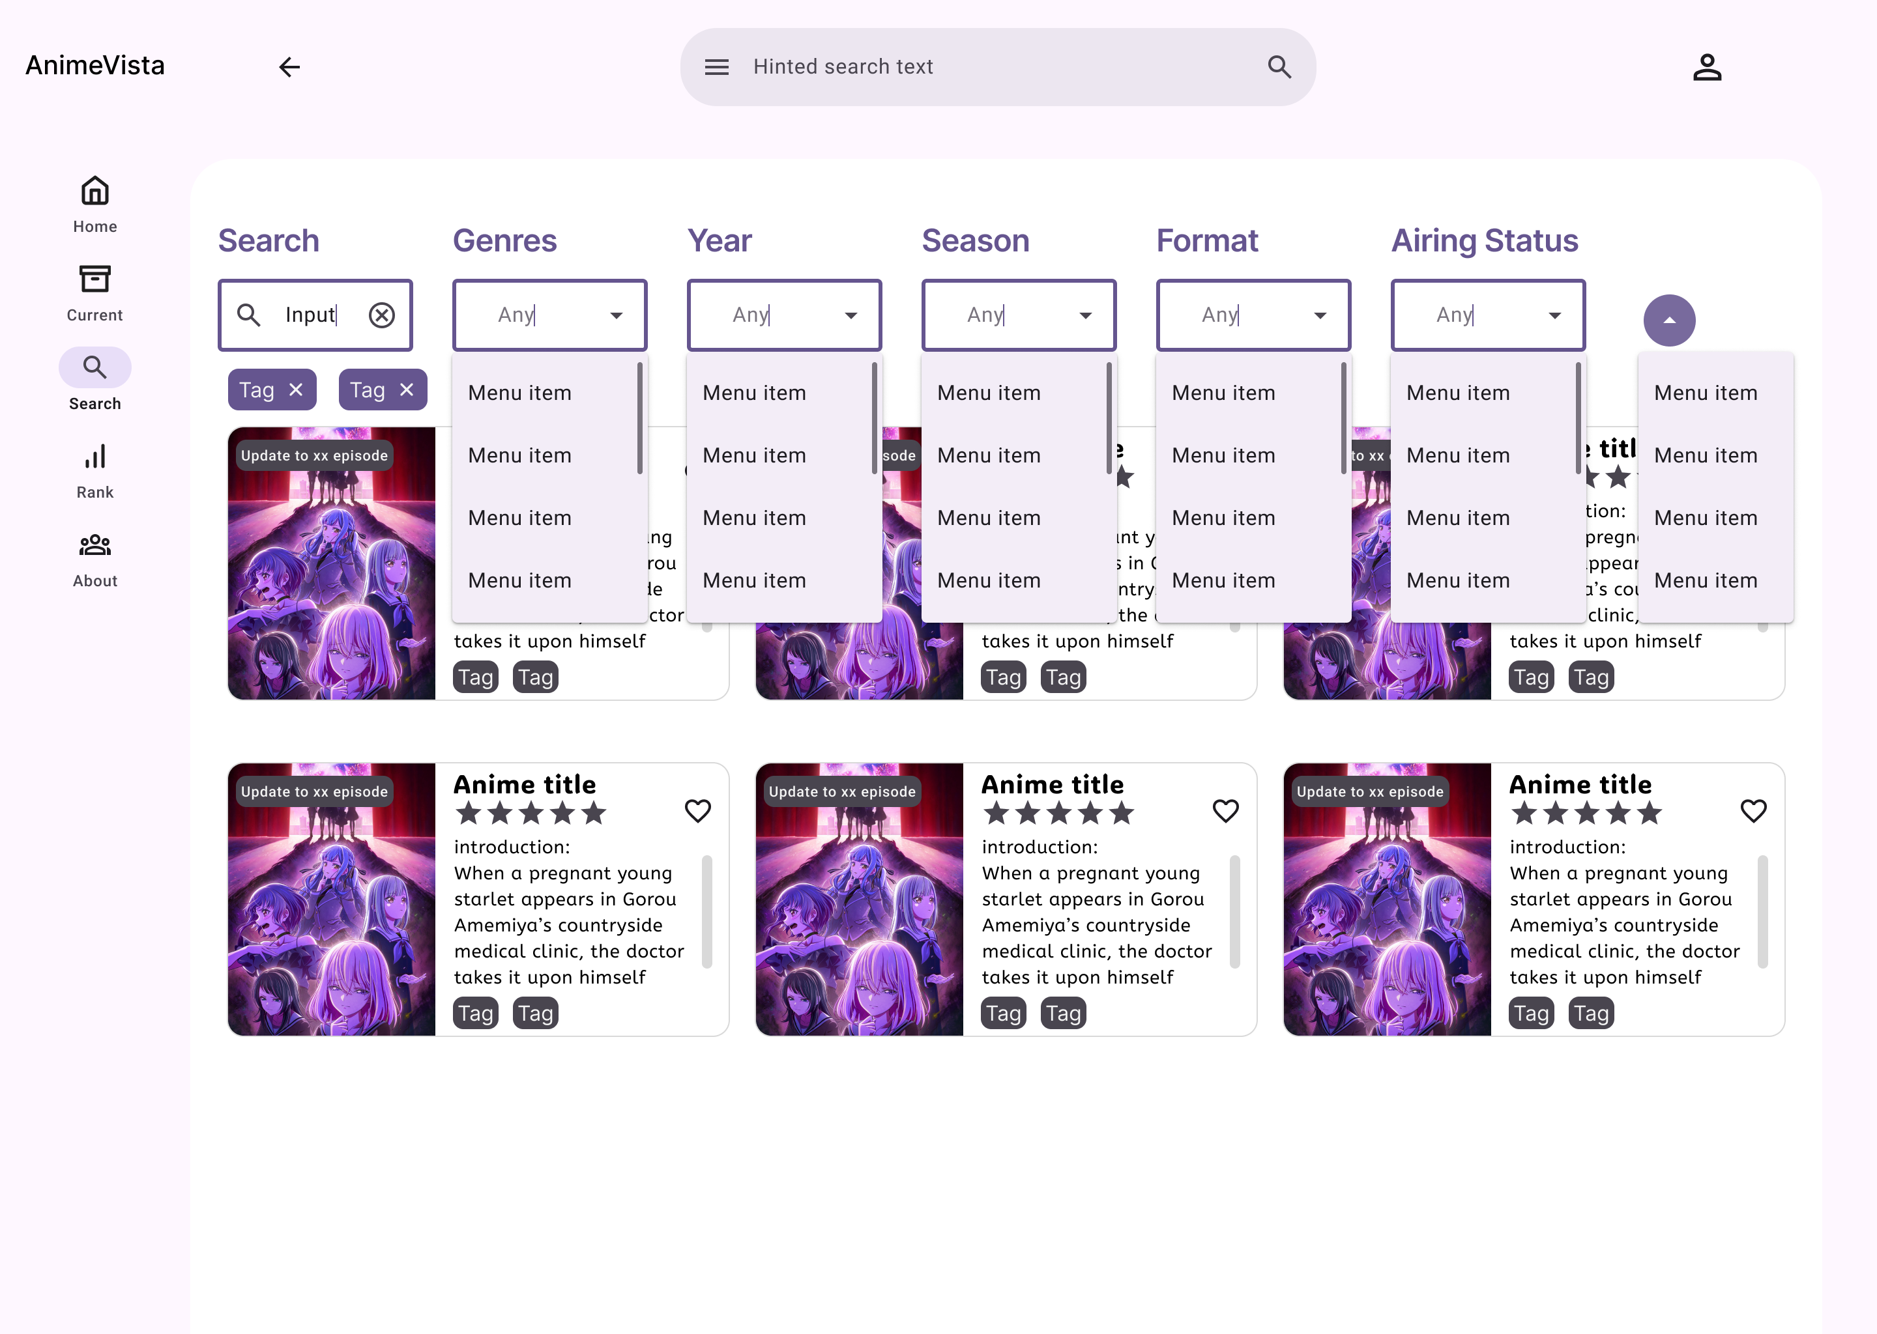
src/presenters/SearchPresenter.jsx
src/views/Search/SearchView.jsx
src/views/Search/components/Filters.jsx
src/views/Search/components/Tags.jsx
src/views/Search/components/Results.jsx
src/views/Search/components/ResultCard.jsx
（复用src/components/card/IntroCard.jsx）
Notes:
页面名：Search
view 目录：src/views/Search
model 目录：src/models/search

Slide 6
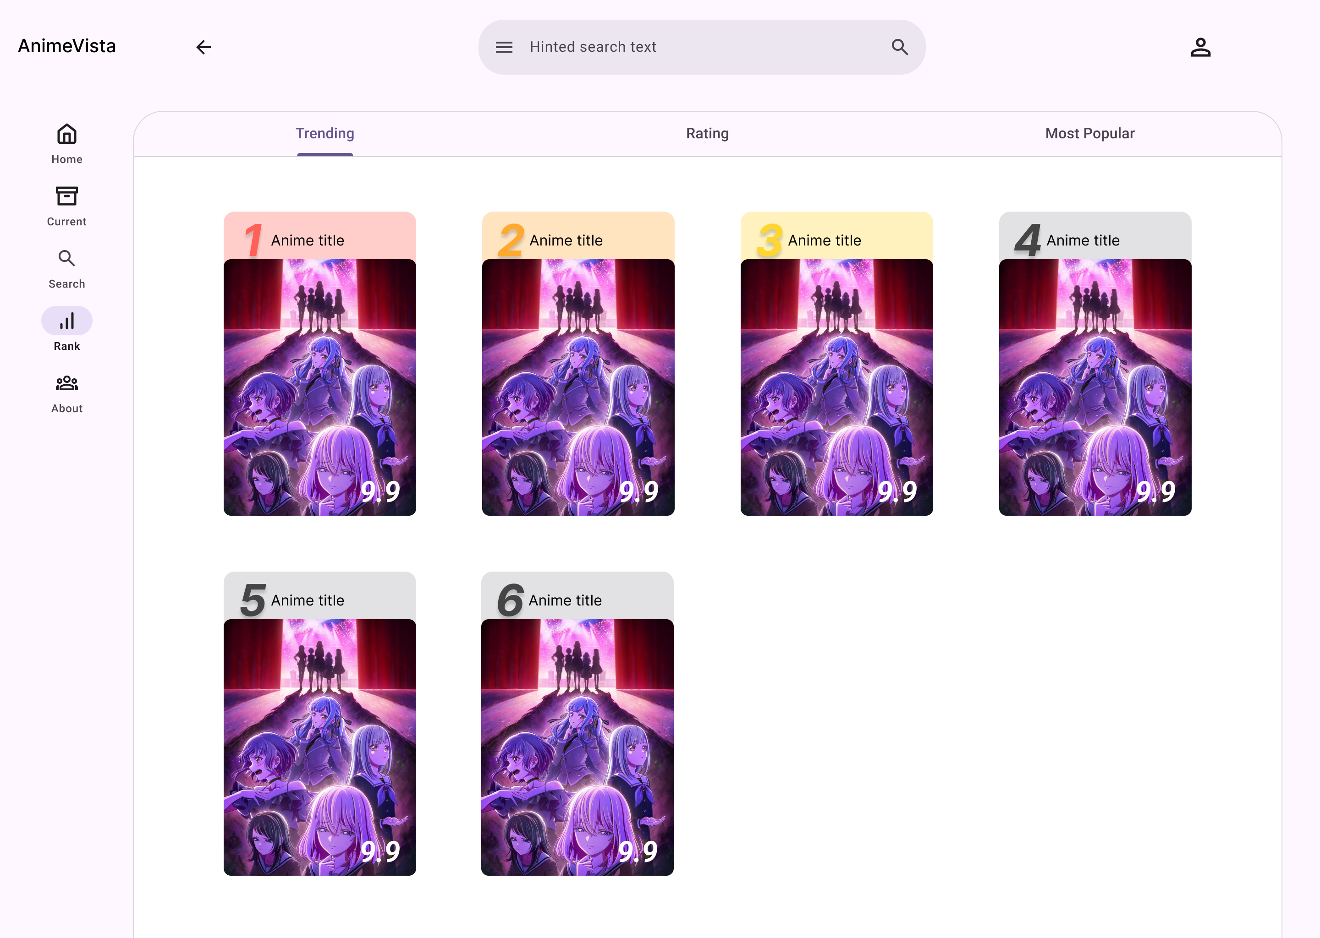
src/presenters/RankPresenter.jsx
src/views/Rank/RankView.jsx
src/views/Rank/components/Conditions.jsx
src/views/Rank/components/Rankings.jsx
src/views/Rank/components/RankingCard.jsx
Notes:
页面名：Rank
view 目录：src/views/Rank
model 目录：src/models/rank

Slide 7
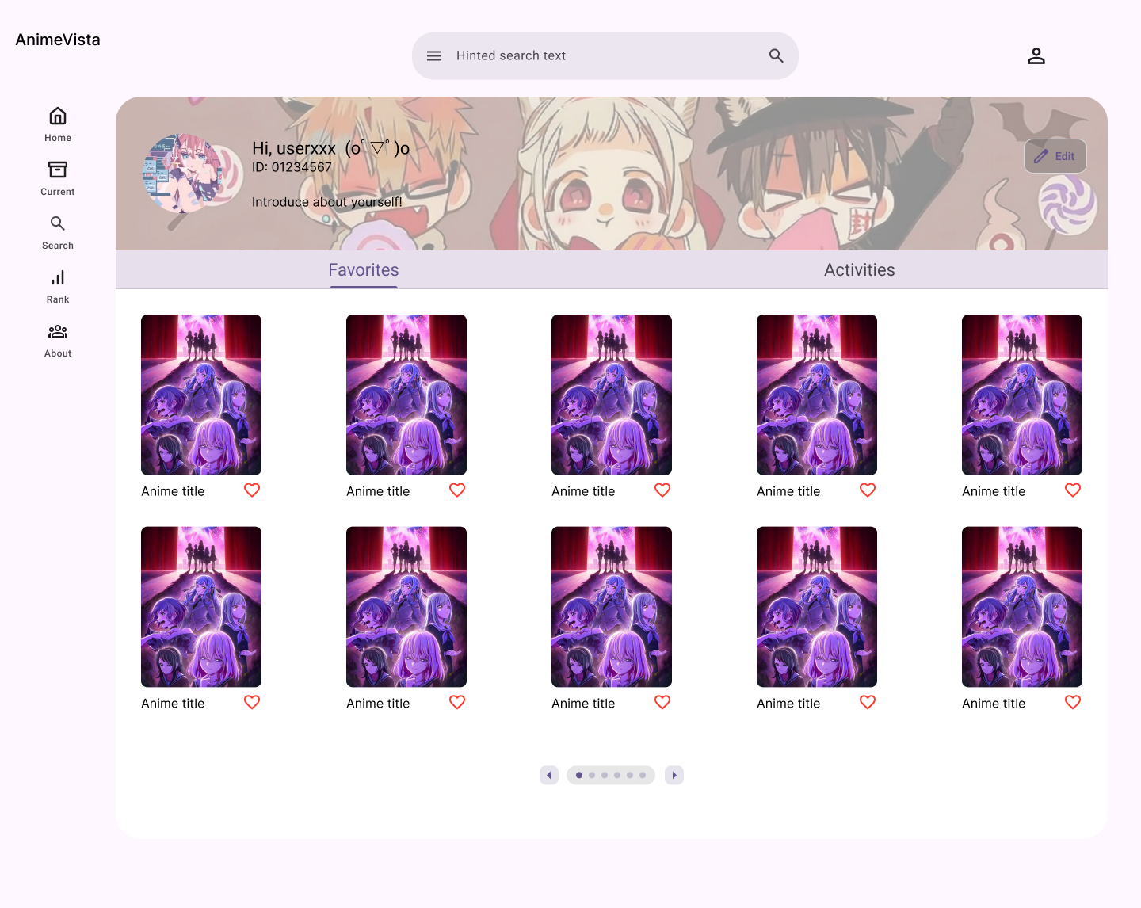
src/presenters/MePresenter.jsx
src/views/Me/MeView.jsx
src/views/Me/components/UserInfo.jsx
src/views/Me/components/Conditions.jsx
src/views/Me/MeFavoritesView.jsx
FavoriteCard
Notes:
页面名：Me – Favorites
view 目录：src/views/Me
model 目录：src/models/user

Slide 8

src/presenters/MePresenter.jsx
src/views/Me/MeView.jsx
src/views/Me/components/UserInfo.jsx
src/views/Me/components/Conditions.jsx
src/views/Me/MeActivitiesView.jsx
src/views/Me/components/ActivitiyCard.jsx
Notes:
页面名：Me – Activities
view 目录：src/views/Me
model 目录：src/models/user

Slide 9
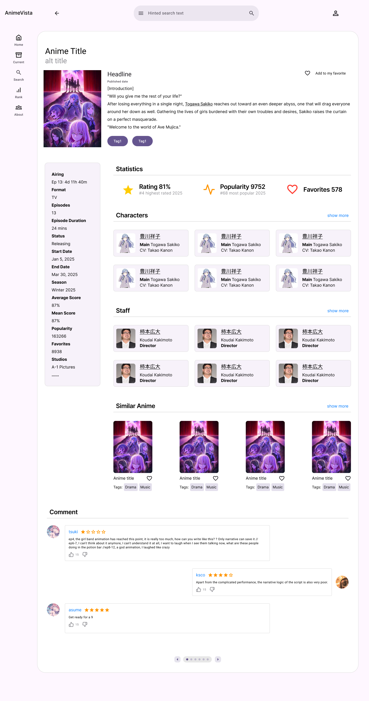
src/presenters/DetailsPresenter.jsx
src/views/Details/DetailsView.jsx
src/views/Details/components/Introduction.jsx
src/views/Details/components/Statistics.jsx
src/views/Details/components/Characters.jsx
src/views/Details/components/CharacterCard.jsx
src/views/Details/components/Parameters.jsx
src/views/Details/components/Staffs.jsx
src/views/Details/components/StaffCard.jsx
src/views/Details/components/Details.jsx
src/views/Details/components/Similarities.jsx
src/views/Details/components/SimilarityCard.jsx
src/views/Details/components/Comments.jsx
src/views/Details/components/CommentCard.jsx
Notes:
页面名：Details
view 目录：src/views/Details
model 目录：src/models/details

Slide 10
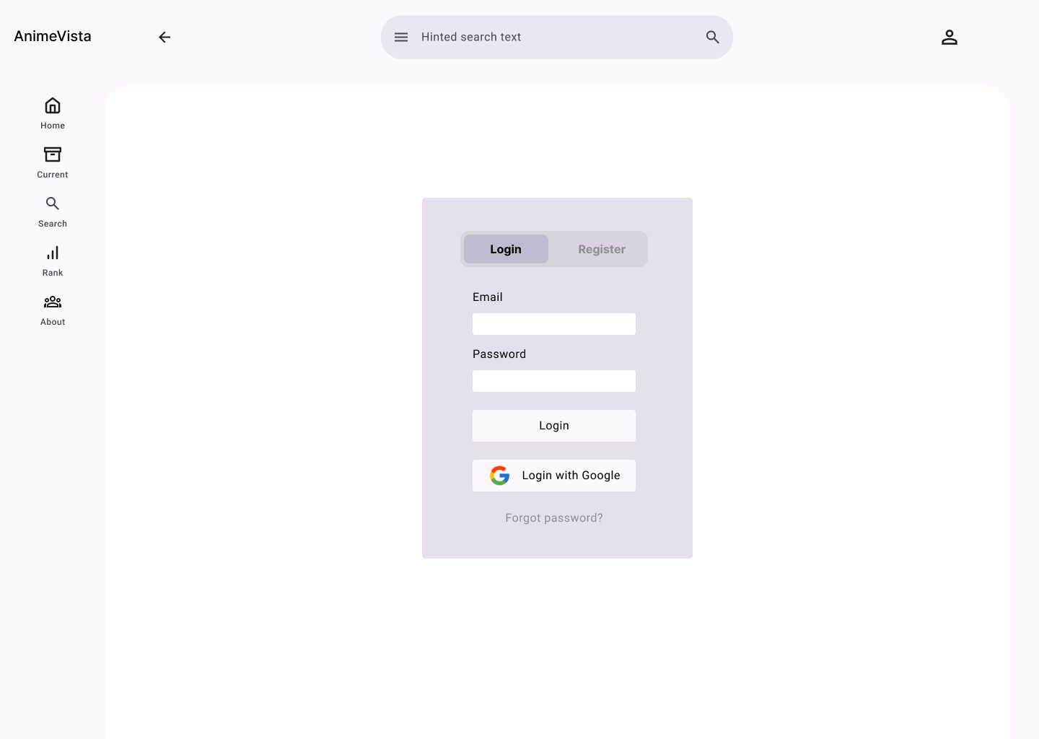
src/presenters/LoginRegisterPresenter.jsx
src/views/LoginRegister/LoginView.jsx
Notes:
页面名：Login
view 目录：src/views/LoginRegister
model 目录：src/models/authentication

Slide 11
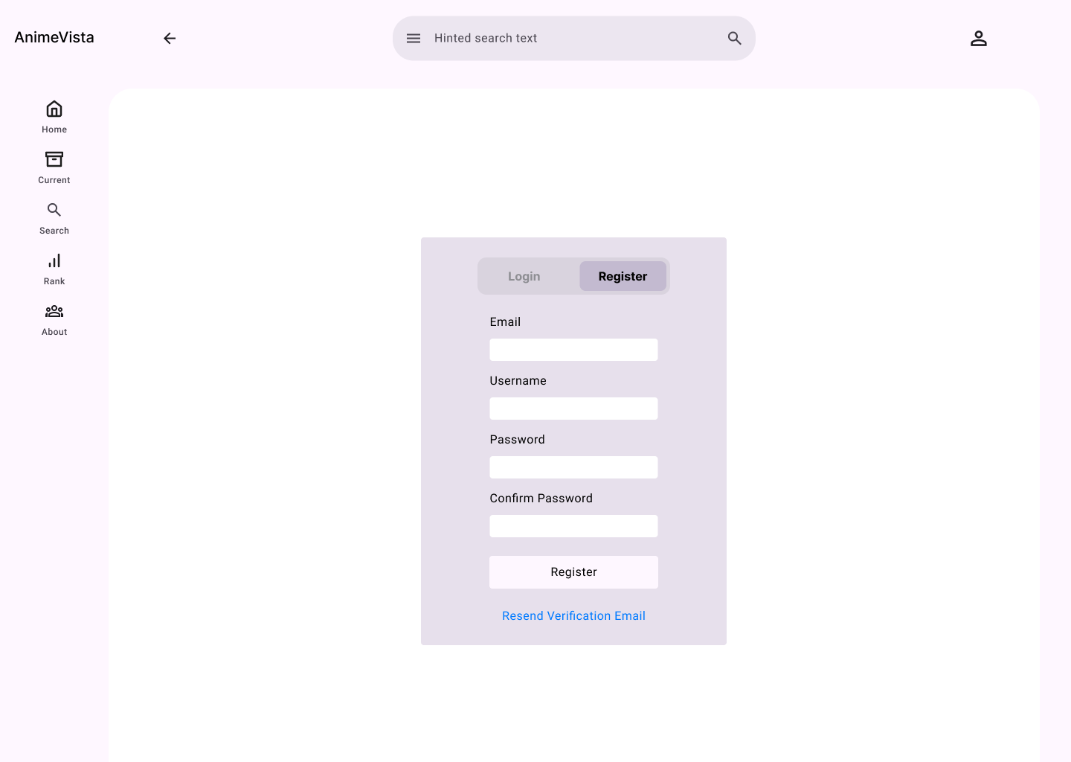
src/presenters/LoginRegisterPresenter.jsx
src/views/LoginRegister/RegisterView.jsx
Notes:
页面名：Register
view 目录：src/views/LoginRegister
model 目录：src/models/authentication

Slide 12
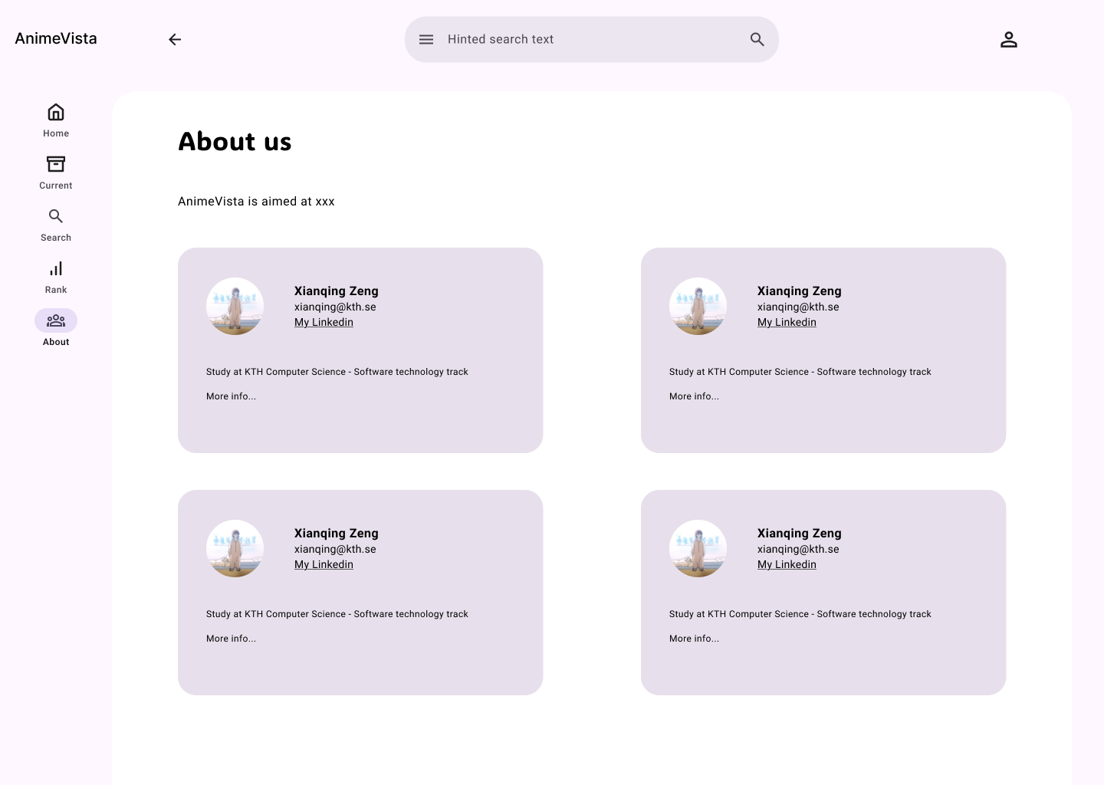
src/presenters/AboutPresenter.jsx
src/views/LoginRegister/RegisterView.jsx
src/views/About/components/DeveloperCard.jsx
Notes:
页面名：About us
view 目录：src/views/About
model 目录：src/models/developer

